Slide 1
Why REST API
The REST API Solution

Slide 2
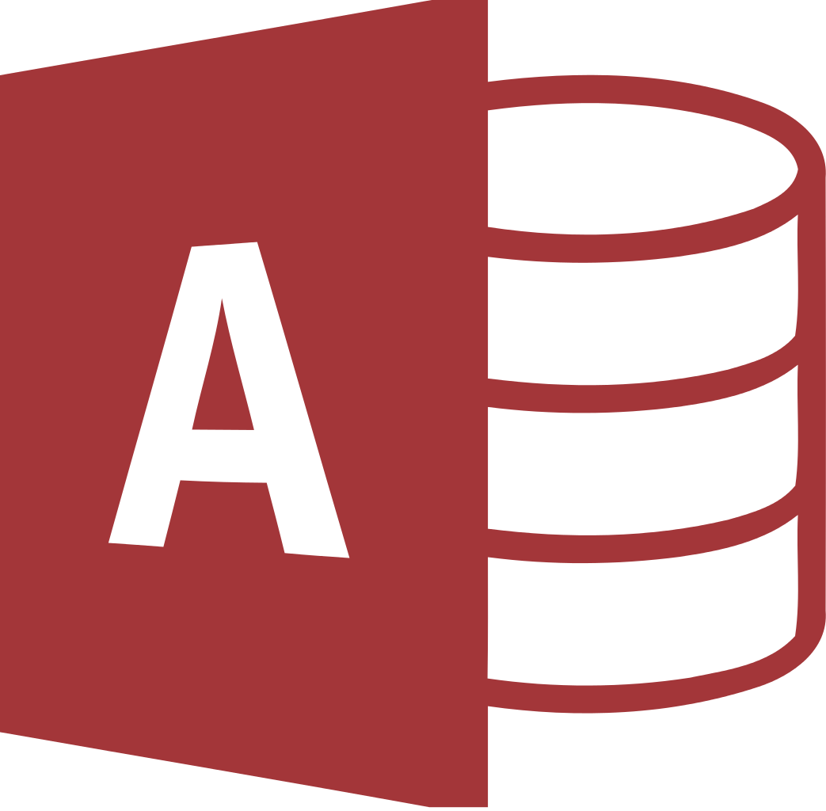

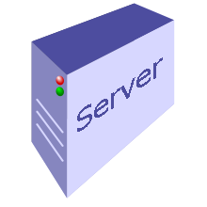


Back in the Day
1995
Notes:
-- Internet Movie Database launched a web site in 1995 that contained information about movies
-- the computer browser would connect to the IMB web server by way of the internet using a protocol called HTTP:
-- the user would connect to the server through the internet
-- the server would connect to the database and run a query
-- the database would respond to the request by returning a response
-- the server would take that response and return it to the client that made the request through the internet using HTTP
-- the computer would accept the response from the server and send the response to the browser in the form of HTML
-- the browser would interpret the HTML and display the information in the browser according to the HTML layout instructions
-- this exciting story is done…

Slide 3
Resources and Representational State
What are Resources
What is Representation State

Slide 4

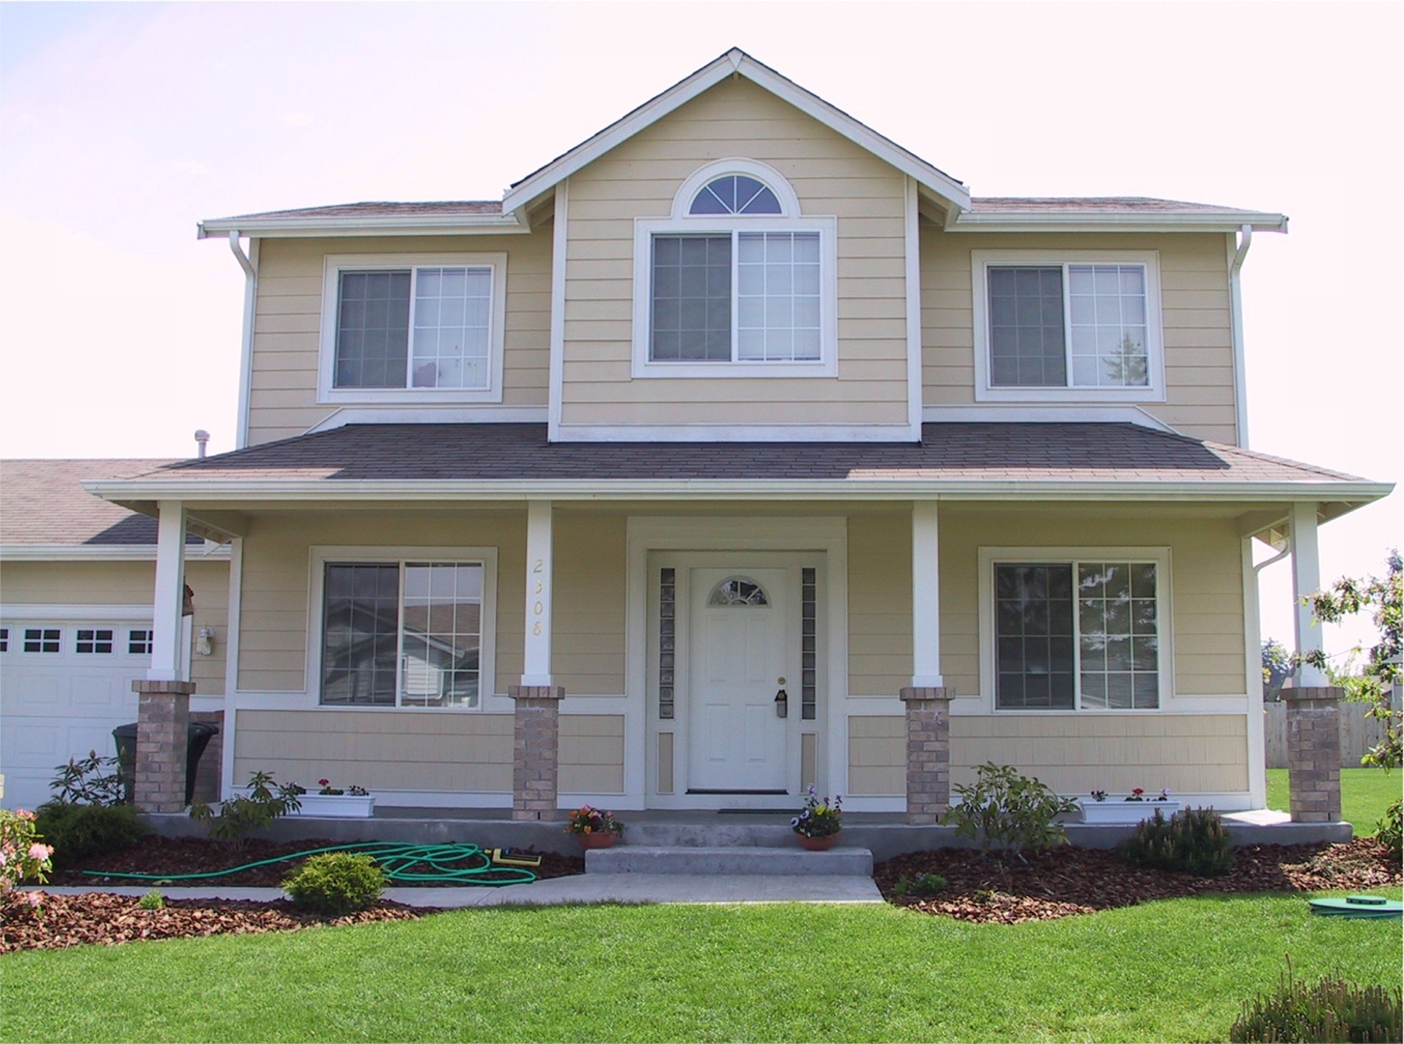
Resources
----- square footages
----- number of rooms
----- number of bath rooms
----- garage size
----- back yard size
---- bedroom footage
---- number of bedrooms
STATE
Notes:
--- in the real world a object is described by a set of attributes
+++ for example, a house can be described by its (click)
----- and also, who owns the house can be considered an attribute
------ these attributes are generally stored in a database (click)
----- The collection of these attributes are called “STATE” (click)
------ and the STATE change of the HOUSE is managed in the database, let’s say Delwar Sells his house to Sarah
------ Then the STATE of the house has changed because an attribute associated with the House has changed

Slide 5

Representational State
Notes:
---- so the house has a Representational STATE that is stored in the database, which means that the house information has the presence of attributes stored in the database
---- their usually are multiple Representational STATE contained in a database

Slide 6

Representational State
REpresentational State Transfer
Notes:
---- now consider an application that will need information surrounding the house contained in the database
---- a program on the computer would run a query and receive the representational state of the targeted house
---- once their query has been satisfied, this is consider as a transformation of the Representational state of the house to the client or computer
---- so what I just describe to you is REST which stands for Representational State Transfer

Slide 7
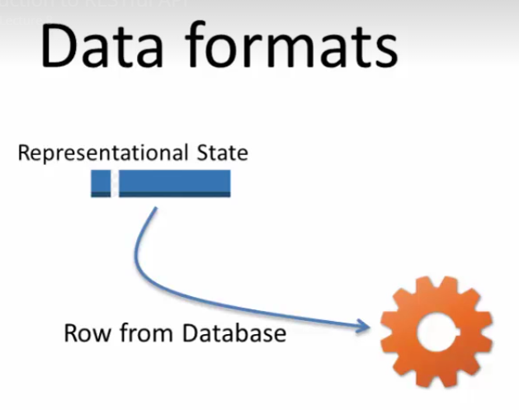
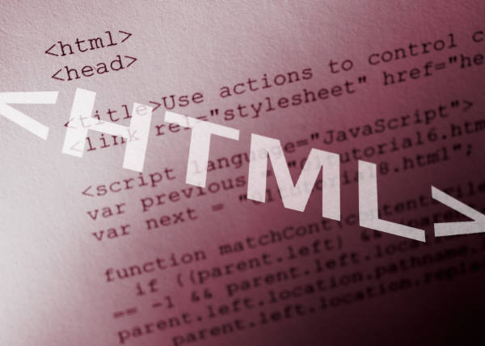
Data Format
What is the format of a Representational State
Notes:
--- The format of a Representational State can be consider to be a row of data from the database that is consumed by some type of logic
---- The Representational State (CLICK) can be converted into any form that you want it to be (CLICK)
+++ for example for a website you would like to generate HTML so that the HTML will be consumed by a browser

Slide 8
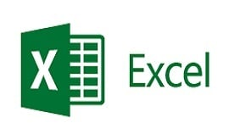


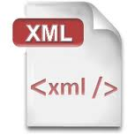

Data Format
What is the format of a Representational State
Notes:
--- the LOGIC could be written to convert this row from the database into (CLICK) XML or (CLICK) JSON, or even (CLICK) TEXT
--- which can be consumed by
A web application
A partner application
A mobile application
or a single page application
--- this logic can also respond in (CLICK) JPEG or EXCEL files or any other format that the request needs to consume

Slide 9
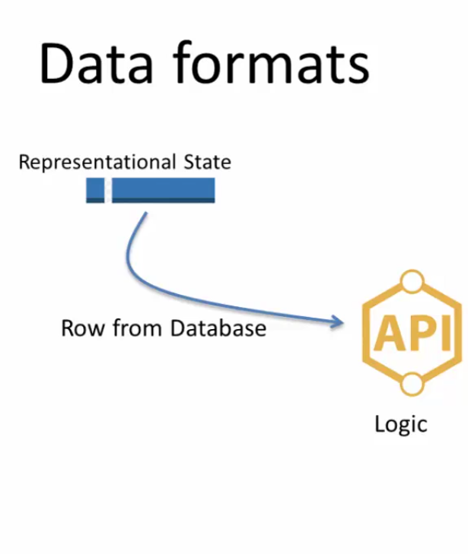
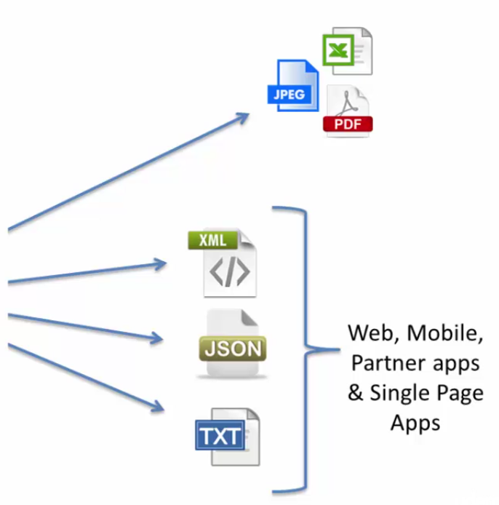
Data Format
Notes:
---- (CLICK) what you see here is an API that is taking the representational state from the back end database
---- and converting it into a format that is desired by the consumer
----- it is common for back end data from the database to be converted into the format that the consumer will consume
------ the request states - that it wants to receive the data in XML format and the back end database returns the response in XML format
------ A REST API is not bound to any one data standard, the RESTful API can turn out the responses in any format
------- and receive a request in any format

Slide 10


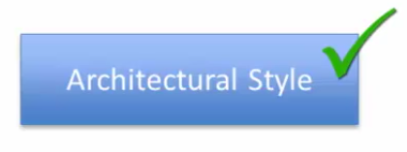
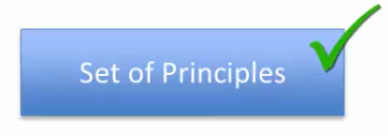
RESTful API
When is an API a RESTful API
Notes:
The answer is simple, an API is RESTful if it has been built using (CLICK) the Architectural Style and it (CLICK) follows the set of principles for RESTful API
---- we will be covering the set of principles and architectural style later in this series

Slide 11


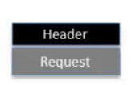
HTTP & REST API
PUT, HEAD, TRACE, OPTIONS
Relationship between HTTP & REST API
URL + Params + Verb = GET, POST
Notes:
---- the relationship between HTTP & REST API
---- A browser client makes a request to the web server using the URL some request parameter and a verb (CLICK) GET or POST
--- the verbs or protocols are PUT, DELETE, HEAD, TRACE, OPTIONS
----- RESTful API use most of these Verbs, the browser uses the GET, and POST
----- when the web server receives a request, the web server response back with the data (CLICK)
----- the DATA has Header and Response

Slide 12
Header and Response
Response code =
200 (OK)
404 (Not found)
500 (Error)
Notes:
---- the header has a field named response code
---- there are many other response codes
---- RESTful API use the headers for request and response and it also uses the response code

Slide 13
Summary
Introduced you to the RESTful API
Much greater details
Resources
Representational State
HTTP
Notes:
----- Resources are objects, things, entities such as house, address
------ resources have representational state managed in the backend
------ you can change the state of the house by changing the owner of the house
------ REST may use HTTP application protocol

Slide 14
Dam it!!!
API is like a___________that is used by________instead of_________
Application, Human, Systems
Application, UI, Humans
UI, Applications, Humans
Human, UI, Application

Slide 15
WTF
XML parsing is sometimes_____intensive
Mobile
CUP
CPU
ROM
FileSystem

Slide 17
This SOB
REST Stands for
Representational State Transfer
Required State Transfer
Representational State Transmission

Slide 18
Who Cares!!
REST Must Use HTTP
True
False

Slide 19
He’s Nuts!!!
SOAP is a _______________based protocol
HTTP
JSON
XML
All the above

Slide 20
This is Annoying
A Resource in the context of REST is (or may be) ________
Thing
Object
Real world entity
An account
An item
A book
All the above

Slide 21
Too Many Dude!!!
In order to invoke an API on developer console most API provider requires the developer to get _________
User ID and Password
API Key
Registered to the site
Anonymous API does NOT require anything

Slide 22
I’m Getting So Sick of This
Companies like Google, WalMart etc offer only JSON based API
TRUE
FALSE

Slide 23
This is not cool!!!
The address of a house is an example of________
Resource
REST
Resource State change
All the above

Slide 24
Here We go Again!!!
RESTFul API make use of the HTTP
Headers (Request and Response)
Verb (GET, POST, DELETE, …)
Reponses code
Body
Parameters (query)
All of the above

